Slide 1




19AIE214-BDA
MOVIE RECOMMENDATION SYSTEM
TEAM INFINITY
APOORVA.M AIE19007
TANUJ.M AIE19041
AISHWARYA.V AIE19068

Slide 2


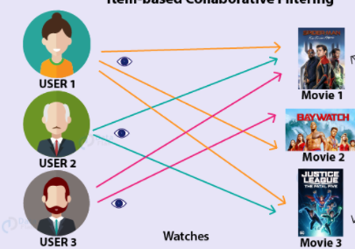
PROBLEM STATEMENT
To implement a movie recommendation system
Incorporate ML algorithm
Platform: Pyspark

Slide 3
Dataset Description
1,000,209 anonymous ratings
3,900 movies
6,040 MovieLens users

Slide 4
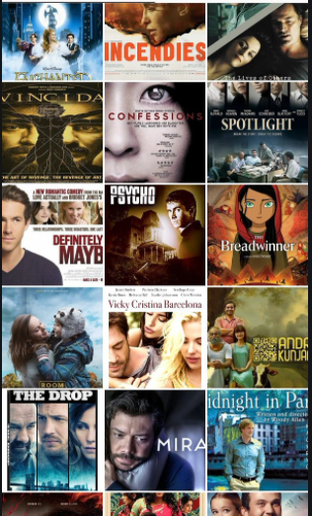
DATASET FILES
UserID::MovieID::Rating::Timestamp
UserID::Gender::Age::Occupation::Zip-code
MovieID::Title::Genres

Slide 5
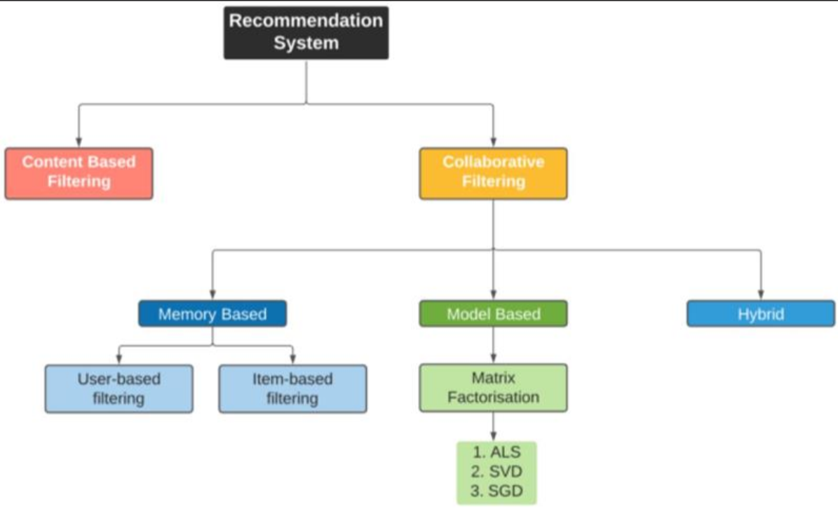
IMPLEMENTATION SYSTEM

Slide 6
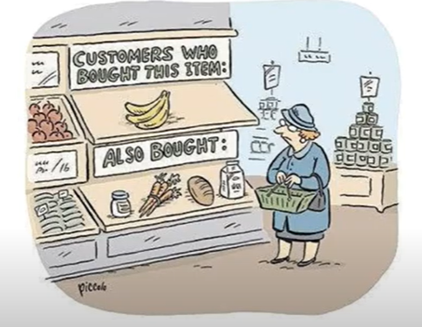
ALGORITHM USED: ALS

Slide 7
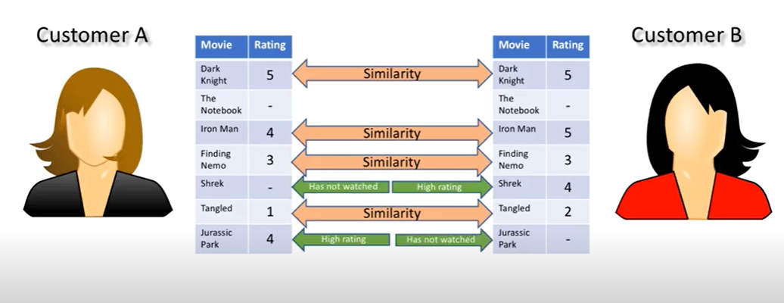

Slide 8
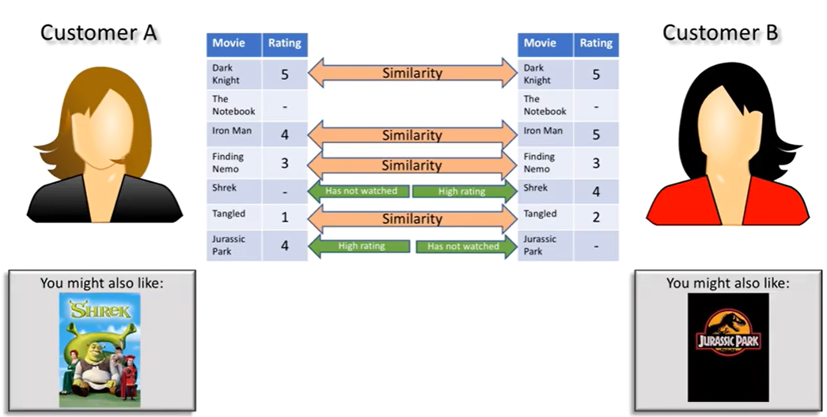

Slide 9

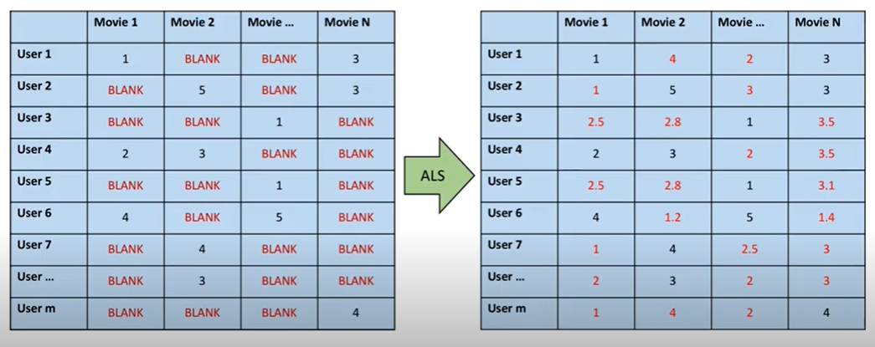

Slide 10
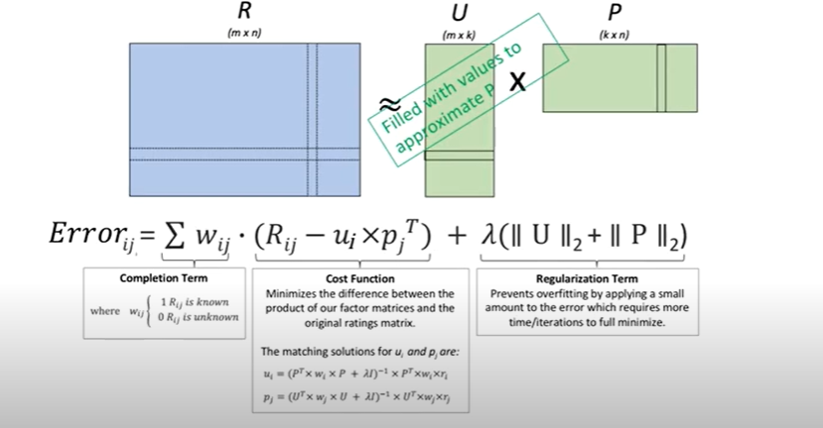

Slide 11
THANK YOU

